Slide 1
Introduction to Computing
for the Social Sciences
Session 5 - Algorithms
David Garcia
Winter Semester 2024-25
20.11.2024

Slide 2
Course Outline
Session 1: Introduction
Session 2: Information Coding
Session 3: Data Structures
Session 4: Programming
Session 5: Algorithms
Session 6: Recursion
Session 7: Sorting Algorithms
Session 8: Time Complexity
Session 9: Formal Languages and Automata
Session 10: Turing Machines and Complexity Classes
Session 11: Databases
Session 12: Parallel Programming
Session 13: Social Science Applications
Session 14: Exam Review

Slide 3
Outline
Algorithms
Representation of Algorithms
Abstract Data Structures
Queues and Stacks
Graphs

Slide 4
What is an algorithm?
Definition
An algorithm is a self-contained step-by-step set of operations to solve a given problem. Algorithms perform calculation, data processing, and/or automated reasoning tasks.

Slide 5

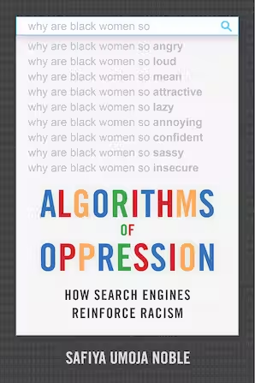
Other uses of the word algorithm
The word algorithm is commonly used nowadays with slightly different meanings, especially in the context of Artificial Intelligence:
Algorithm as method to fit a predictive model. Can be as simple as least squares to fit linear regression and as complicated distributed stochastic gradient descent to fit neural networks
Algorithm as the model after training. This focuses on the predictive model as a program with a behavior that is not carefully designed, but learned from empirical data.
Related terms to these other meanings: algorithmic bias, algorithmic media,
machine behavior, algorithm auditing, algorithmic decision-making…

Slide 6

al-Khwarizmi: the namesake of algorithms
Muhammad ibn Musa abu Djafar al-Khwarizmi (780 – 850, Khwarazm, Uzbekistan)
Popularized algebra and published the first systematic way to solve linear and quadratic equations
His book on how to calculate with Hindu-Arabic numerals was translated into Latin with the title Algoritmi de Numero Indorum
Algoritmi later changed to Algorithmus as a mix with arithmos in Greek (number)
It is clear that algorithms predate him (e.g. in Babylon, Egypt, India, and Greece)
He widely popularized the idea of systematic treatment of data (numbers)
He emphasized doing this in as few steps as possible - thus using a decimal system with pen and paper rather than Roman numerals with an abacus

Slide 7
Algorithms: python example
Procedure KSmallestElement(M, n, k)
Inputs:
M: an array n: the number of elements in M
k: the index of the k-th smallest element (given the list is sorted in ascending order)
Result: The k-th smallest element
For i = 1 to k:
smallest ← i
For j = i + 1 to n:
If M[j] < A[smallest], then smallest ← j.
Swap M[i] with M[smallest]
return M[k-1]
Example: k^{th} smallest element in a list
input: list M of length n, index k
data: i, j, m, min_val output: k^{th} smallest element in M
def min_k(M, k):
for i in range(0, k):
m = i
min_val = M[i]
for j in range(i+1,len(M)):
if M[j] < min_val:
m = j
min_val = M[j]
M[i], M[m] = M[m], M[i]
return M[k-1]

Slide 8
Algorithms: properties
Specification:
input specification: required input such that a given output can be produced (many or no inputs)
output specification: result to be produced by the algorithm
Example: k^{th} smallest element in a list
input: list M of length n, index k
data: i, j, m, min_val output: k^{th} smallest element in M
def min_k(M, k):
for i in range(0, k):
m = i
min_val = M[i]
for j in range(i+1,len(M)):
if M[j] < min_val:
m = j
min_val = M[j]
M[i], M[m] = M[m], M[i]
return M[k-1]

Slide 9
Algorithms: properties
Transferability:
input should be parameterizable
different instances of the problem must be allowed as inputs
The example allows lists of any possible length, not just one length
It also allows to find any kth smallest element, not just for one k
Example: k^{th} smallest element in a list
input: list M of length n, index k
data: i, j, m, min_val output: k^{th} smallest element in M
def min_k(M, k):
for i in range(0, k):
m = i
min_val = M[i]
for j in range(i+1,len(M)):
if M[j] < min_val:
m = j
min_val = M[j]
M[i], M[m] = M[m], M[i]
return M[k-1]

Slide 10
Algorithms: properties
Description:
finiteness: must terminate after a finite number of steps
definiteness: each step must be clear, well-defined and precise (no ambiguity).
Execution and return, alternatives:
deterministic: same output for same input(s)
stochastic: a random component makes the output vary for the same input(s)
Example: k^{th} smallest element in a list
input: list M of length n, index k
data: i, j, m, min_val output: k^{th} smallest element in M
def min_k(M, k):
for i in range(0, k):
m = i
min_val = M[i]
for j in range(i+1,len(M)):
if M[j] < min_val:
m = j
min_val = M[j]
M[i], M[m] = M[m], M[i]
return M[k-1]

Slide 11
Algorithms: properties
Time complexity:
effort the given algorithm needs for completion
is dependent on specific implementation
measured by counting the number of key operations such as comparisons in the sorting algorithm
Memory complexity:
required memory during execution
measured by counting the maximum memory space required by the algorithm
Example: k^{th} smallest element in a list
input: list M of length n, index k
data: i, j, m, min_val output: k^{th} smallest element in M
def min_k(M, k):
for i in range(0, k):
m = i
min_val = M[i]
for j in range(i+1,len(M)):
if M[j] < min_val:
m = j
min_val = M[j]
M[i], M[m] = M[m], M[i]
return M[k-1]

Slide 12
Algorithms: properties
Correctness:
partial correctness: every step in the algorithm must to be correct
terminates: for correct inputs, the algorithm must always terminate in a finite number of steps
Example: k^{th} smallest element in a list
input: list M of length n, index k
data: i, j, m, min_val output: k^{th} smallest element in M
def min_k(M, k):
for i in range(0, k):
m = i
min_val = M[i]
for j in range(i+1,len(M)):
if M[j] < min_val:
m = j
min_val = M[j]
M[i], M[m] = M[m], M[i]
return M[k-1]

Slide 13
Representation of Algorithms
Algorithms
Representation of Algorithms
Abstract Data Structures
Queues and Stacks
Graphs

Slide 14
Representation
How to create a new program?
Evaluate your requirements
Define a structure for programming with a method of representation for its algorithm:
Pseudocode
Structograms
Flow diagrams
UML Unified modelling language
Start programming

Slide 15
Representation
How to create a new program?
Evaluate your requirements
Define a structure for programming with a method of representation for its algorithm:
Pseudocode
Structograms
Flow diagrams
UML Unified modelling language
Start programming

Slide 16
Representation
How to create a new program?
Evaluate your requirements
Define a structure for programming with a method of representation for its algorithm:
Pseudocode
Structograms
Flow diagrams
UML Unified modelling language
Start programming
[https://en.wikipedia.org/wiki/Unified_Modeling_Language]
[https://www.lucidchart.com/pages/what-is-UML-unified-modeling-language]

Slide 17
Pseudocode
representation of the steps in an algorithm as a combination of natural language and mathematical notation
often uses structural conventions of a programming language
not for machine interpretation but for illustration purposes among humans
Example
input: input variables
data: auxiliary variables
output: output variables
begin
preparation;
while not trivial case do
work;
bookkeeping;

Slide 18
Good pseudocode
Example
input: input variables
data: auxiliary variables
output: output variables
begin
preparation;
while not trivial case do
work;
bookkeeping;
Specify input and output if not clear from the context (problem)
If you use auxiliary data structures, comment how to access and edit them
Make sure loops and conditional scopes are unambiguous
Bottom line: using your pseudocode, another human has to be able to follow its instructions to solve the problem with pen and paper (and later program it)

Slide 19
Flowcharts
graphical representation of execution of algorithm using symbols and transitions
shows the steps as boxes, and their order by connecting the boxes with arrows.
start
Read Selling Price (SP)
Read Cost Price (CP)
✔️
Profit = SP - CP
SP >= CP
❌️
Loss = CP - SP
Output Loss
Output Profit
stop

Slide 20
Flowcharts
program start and end
beginning and ending of a program or sub-process.
data
process of inputting/entering and outputting/displaying data
execute operations
set of operations that changes value, form, or location of data
conditional split
conditional operation that determines the program path
commonly a yes/no question or true/false test
start/stop
input & output
operation
split
no
yes

Slide 21
Flowchart example
The program starts and reads selling price as SP
Then reads cost price as CP
The program tests if SP is larger than or equal CP
If the condition is true, it takes the right path:
Calculate profit as SP-CP
Output profit
if the condition is false, it takes the bottom path:
Calculate loss as CP - SP
Then output loss
Program ends
start
Read Selling Price (SP)
Read Cost Price
(CP)
✔️
SP >= CP
Profit = SP - CP
❌️
Loss = CP - SP
Output Loss
Output Profit
stop

Slide 22
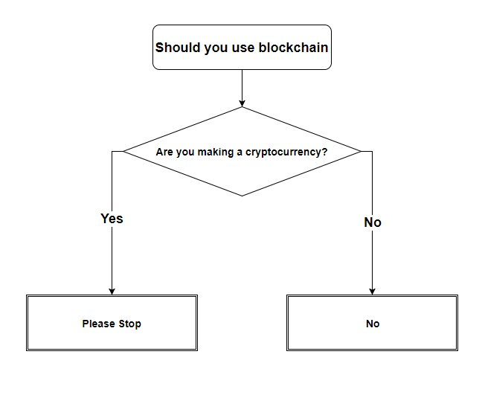
Flowchart example
https://www.reddit.com/r/ProgrammerHumor/comments/7etmm1/a_diagram_to_help_you_decide_whether_blockchain/

Slide 23
Abstract Data Structures
Algorithms
Representation of Algorithms
Abstract Data Structures
Queues and Stacks
Graphs

Slide 24
Abstract Data Structures
Characteristics
represent data in a way best suited to our (algorithmic) needs
arrangement, coding and link among data matter
allow for administration and access to data in an efficient way
exact specification is dependent on implementation and the use case
We already saw a number of abstract data structures
arrays
linked lists
heaps (= binary trees)
associative arrays (= dictionaries)
Choice of data structure matters a lot for performance of specific algorithms
next: illustrative examples for each structure

Slide 25
Queues
Enqueue
Linear data structure following the FIFO principle: First In, First Out
Two operations:
Enqueue(Q, v): add element v to the rear of the queue Q
Dequeue(Q): remove and return element from the front of the queue Q
Example applications:
processing requests in order
having several queues for priority
Rear ➡
Dequeue
Front ➡

Slide 26
Stacks
Linear data structure following the LIFO principle: Last In, First Out
Two operations:
Push(S,v): add an element v to the top of the stack S
Pop(S): remove and return the most recently added element, i.e. top of the stack S
Example applications:
Stack segment of the memory
management of layered execution of sub-routines
Recursion: more details in next session
Push item
Pop item
Top ➡

Slide 27
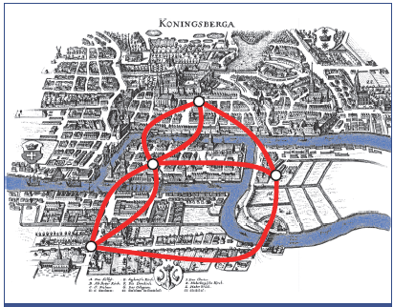
Graphs: motivation
Leonhard Euler: Seven bridges of Königsberg
Problem: Find a path that uses every bridge exactly once and ends in the same place.
Example of a graph representation in a problem that motivated graph theory
By Peter Berger: Einführung in die Graphentheorie

Slide 28
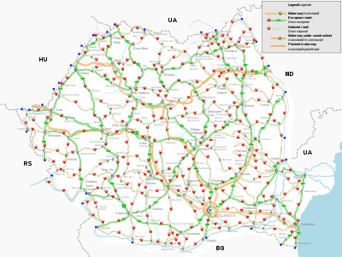

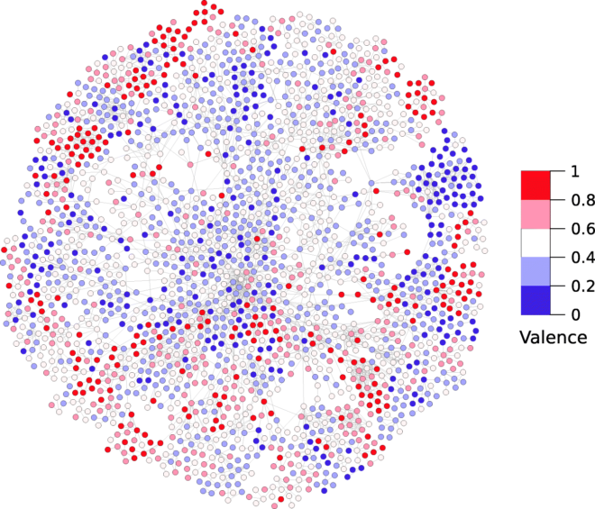
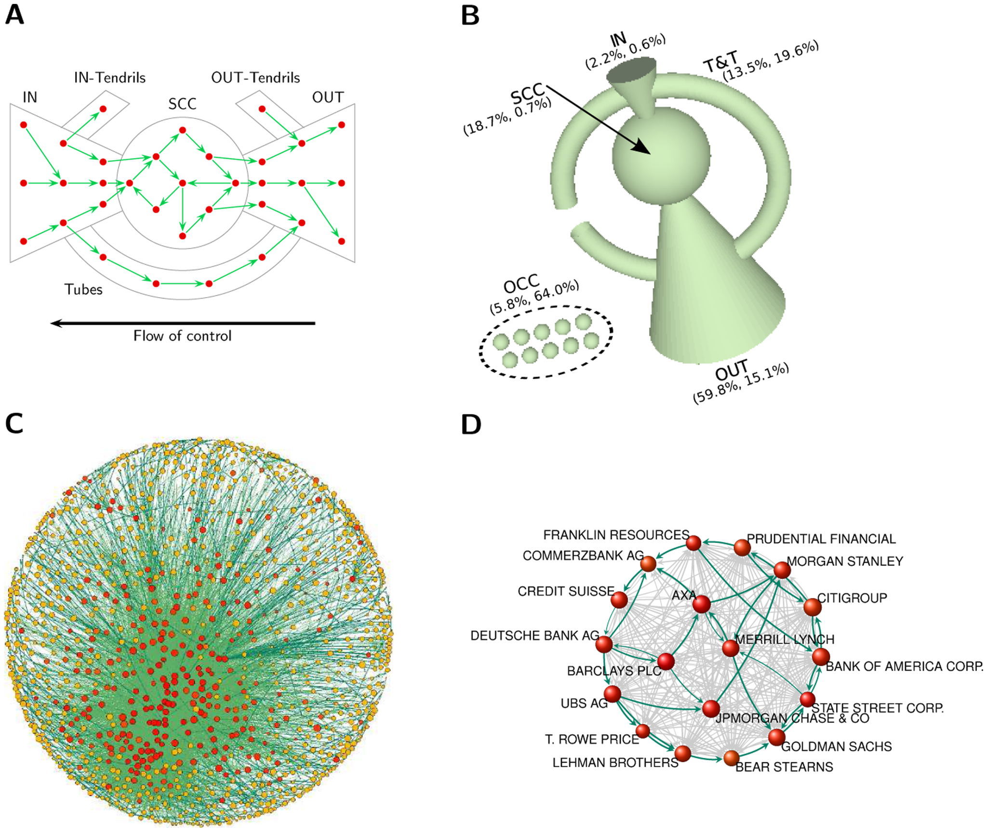
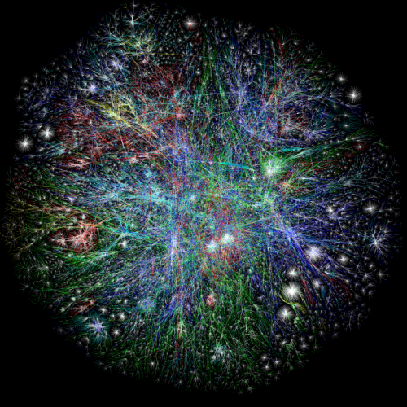
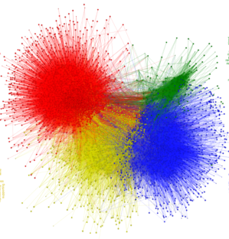
Graph examples
Many real-world structures can be represented as graph. Examples are:
A road map
The Internet
Word associations
Ownership between companies
The Web
Social relations

Slide 29
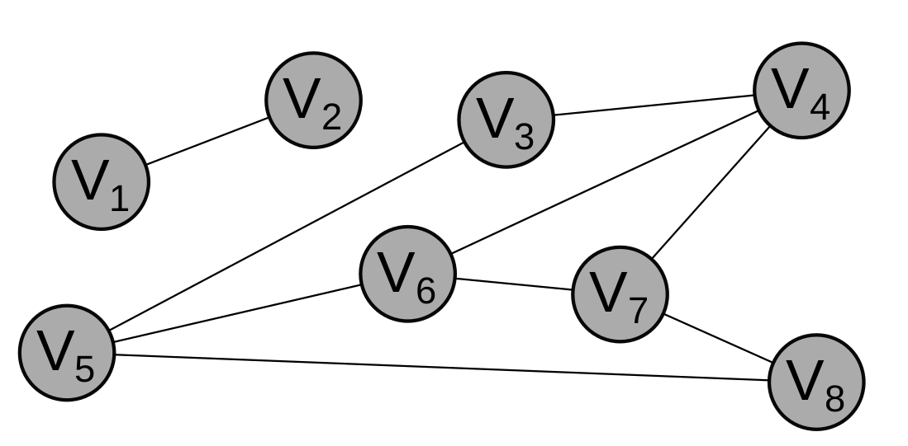
Graphs
consist of vertices and edges
especially suitable to represent interdependencies between data points

Slide 30
Graphs
vertices represent any object
cities, physical, states, atoms, steps in a process, persons
can be labeled or not
edges represent the relationship between nodes
roads between cities, transitions between physical states, atomic bonds etc.
edges can have labels and variables, for example
physical distance (e.g. 2 Km in a map)
type of connection (e.g. friends or enemies)
weight of connection (e.g. strong versus weak)
can be directed or undirected

Slide 31
Graphs: Formalization
A graph G is a tuple G = (V, E), where
V is the set of all vertices
E is the set of all edges
For directed graphs, E consists of ordered pairs (v₁,v₂), i.e., the edge goes from v₁ to v₂
For undirected graphs E is an unordered tuple {v₁,v₂}
How do we represent graphs as an abstract data structure?

Slide 32
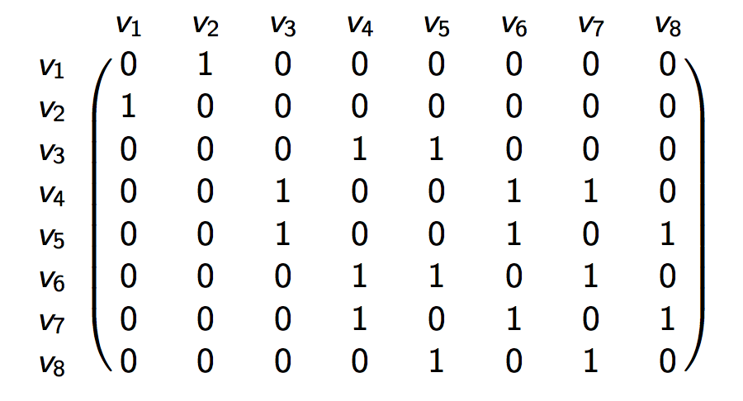
Adjacency Matrix
Definition of Adjacency Matrix If G = (V, E) is a graph then two vertices v, w ∈ V are adjacent if they are connected by an edge {v, w} ∈ E. The matrix A(G) is called adjacency matrix if a_{v,w} = 1 if {v, w} ∈ E and a_{v,w} = 0 otherwise.

Slide 33
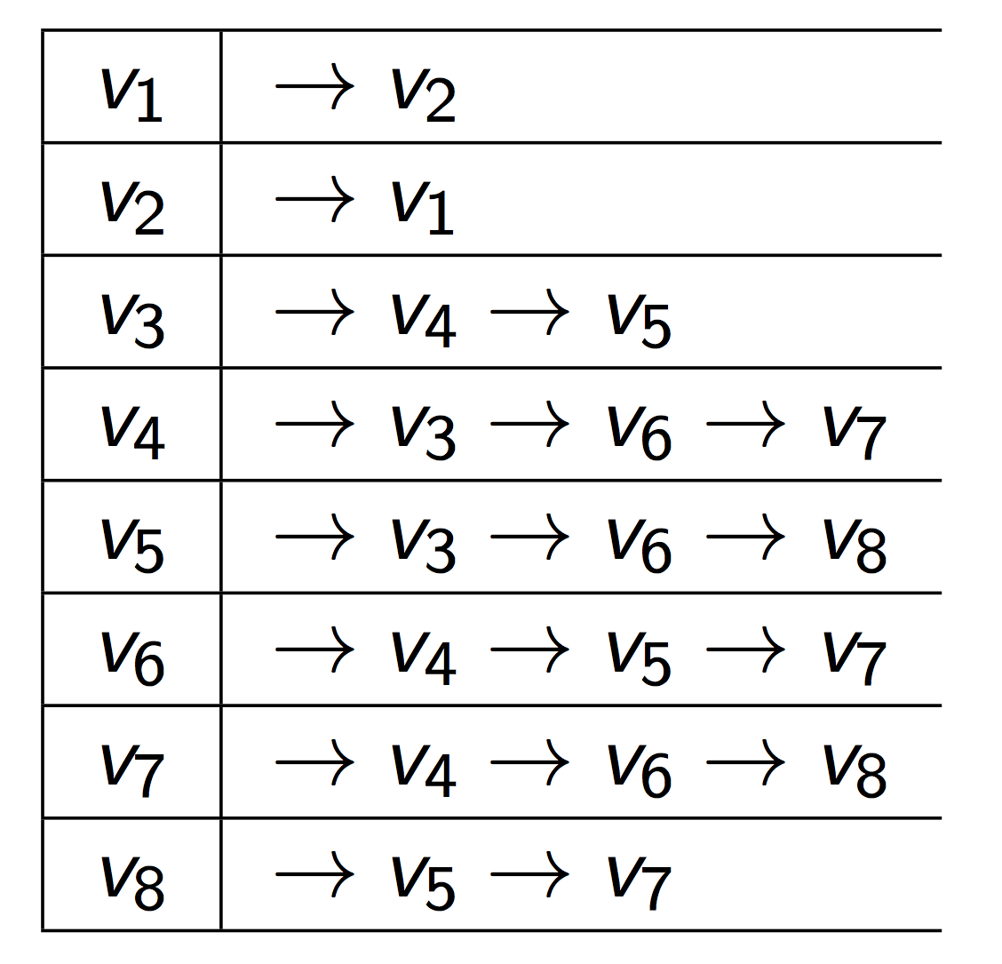
Adjacency list
Adjacency list: Alternative representation to adjacency matrix
array of vertices in which all neighbors are stored as a linear list
compressed representation of an adjacency matrix where all zeros have been eliminated. More memory efficient for sparse graphs.

Slide 34
Adjacency Matrix vs Adjacency List
Comparing adjacency matrix and list representation
example 1: does an edge exist between v_{i} and v_{j}?
adjacency matrix: direct access
adjacency list: iterate through all neighbors
example 2: how many edges does a vertex v_{i} have?
adjacency matrix: iterate through all vertices
adjacency list: iterate only through all neighbors
choice of representation clearly matters for access efficiency
Adjacency lists are more memory efficient for sparse networks (few edges per node)
If Facebook stored the friendship network data of 2.7 Billion users as an adjacency matrix and each entry in the matrix took just one bit, it would take 455 Petabytes (455.000 Terabytes) to store just the presence or absence of friendships between users.

Slide 35
Examples of Graph Problems
Finding distances between nodes and shortest paths
Finding subgraphs that are connected: i.e. there are paths between every to nodes in the subgraph
Coloring nodes such that two neighbors do not have the same color
Finding the nodes with the shortest average distance to all other nodes
Ranking nodes by the number of shortest paths that go through them
Finding a tree that connects all nodes with the lowest number of edges
Finding a path connecting all nodes and using edges at most once
Finding if two graphs can be mapped into each other (isomorphism)

Slide 36
Example: Finding distances
Let’s consider this (undirected) graph G = (V, E) with V = {a,b,c,d,e,f,g} and E = {{a,e}, {e,b}, {b,c}, {c,f}, {c,g}, {d,g}, {e,f}}
b
c
d
a
e
f
g
Problem: Given a source node (aka starting node) s,
find all reachable nodes from it and
find a shortest path to each of them from s
→To do so use the Breadth-First Search (BFS) algorithm

Slide 37
Algorithm: Breadth-First Search
First step is to initialise the Graph using the InitialiseBFS(G,s) function.
Procedure InitialiseBFS(G, s)
Inputs:
G: an undirected graph s: the starting node
Result: A graph initialised for the Breadth-First-Search starting at node s
For each vertex u in G.V/{s}
color [u] ← WHITE
d [u] ← ∞ # distance
π [u] ←NIL # parent
color [s] ←GRAY
d [s] ← 0
π [u] ←NIL
Initializing with starting node s = c gives:
NIL
NIL
NIL
NIL
b
c
d
a
∞
0
∞
∞
∞
∞
∞
e
f
g
NIL
NIL
NIL
Distance is noted inside the nodes
Name of the nodes are above or below the node
Parent is denoted over or below the name in gray and capital letter (as of now NIL for all nodes)

Slide 38
Algorithm: Breadth-First Search
Procedure BFS(G, s)
Inputs:
G: an undirected graph s: the starting node
Result: A graph with the distance of each node to the source and their parents is stored.
InitialiseBFS(G,s)
Q ← ∅
Enqueue (Q, s) # put s in the Queue Q
While Q ≠ ∅:
u ← Dequeue (Q) # take the next element from the Queue Q
For each vertex v in neighbors(u): # check all neighbors
if color [v] = WHITE # only continue if neighbor not been processed yet
then color [v] ← GRAY # mark node as processed
d [v] ← d [u] + 1 # set distance to one greater as the prior node
π [v] ← u # set prior node as parent
Enqueue (Q, v) # put v in the Queue Q
color [u] ← BLACK # mark that all neighbors have been processed

Slide 39
Algorithm: Breadth-First Search
Next initialize the Queue Q
Procedure BFS(G, s)
Inputs: …
Result: …
InitialiseBFS(G,s)
Q ← ∅
Enqueue (Q, s)
While Q ≠ ∅:
u ← Dequeue (Q)
For each vertex v in neighbors(u):
if color [v] = WHITE
then color [v] ← GRAY
d [v] ← d [u] + 1
π [v] ← u
Enqueue (Q, v)
color [u] ← BLACK
NIL
NIL
NIL
NIL
b
c
d
a
∞
0
∞
∞
∞
∞
∞
e
f
g
NIL
NIL
NIL
Q: | c
 | 0

Slide 40
Algorithm: Breadth-First Search
Iterate through the first while-loop for u←c
Procedure BFS(G, s)
Inputs: …
Result: …
InitialiseBFS(G,s)
Q ← ∅
Enqueue (Q, s)
While Q ≠ ∅:
u ← Dequeue (Q)
For each vertex v in neighbors(u):
if color [v] = WHITE
then color [v] ← GRAY
d [v] ← d [u] + 1
π [v] ← u
Enqueue (Q, v)
color [u] ← BLACK
C
NIL
NIL
NIL
b
c
d
a
1
0
∞
∞
∞
1
1
e
f
g
NIL
C
C
Q: | c | b | f | g
 | 0 | 1 | 1 | 1

Slide 41
Algorithm: Breadth-First Search
Iterate through the next while-loop for u←b (b ist next in the queue - fifo)
Procedure BFS(G, s)
Inputs: …
Result: …
InitialiseBFS(G,s)
Q ← ∅
Enqueue (Q, s)
While Q ≠ ∅:
u ← Dequeue (Q)
For each vertex v in neighbors(u):
if color [v] = WHITE
then color [v] ← GRAY
d [v] ← d [u] + 1
π [v] ← u
Enqueue (Q, v)
color [u] ← BLACK
C
NIL
NIL
NIL
b
c
d
a
1
0
∞
∞
2
1
1
e
f
g
B
C
C
Q: | b | f | g | e
 | 1 | 1 | 1 | 2

Slide 42
Algorithm: Breadth-First Search
Iterate through the next while-loop for u←f
Procedure BFS(G, s)
Inputs: …
Result: …
InitialiseBFS(G,s)
Q ← ∅
Enqueue (Q, s)
While Q ≠ ∅:
u ← Dequeue (Q)
For each vertex v in neighbors(u):
if color [v] = WHITE
then color [v] ← GRAY
d [v] ← d [u] + 1
π [v] ← u
Enqueue (Q, v)
color [u] ← BLACK
C
NIL
NIL
NIL
b
c
d
a
1
0
∞
∞
2
1
1
e
f
g
B
C
C
Q: | f | g | e
 | 1 | 1 | 2

Slide 43
Algorithm: Breadth-First Search
Iterate through the next while-loop for u←g
Procedure BFS(G, s)
Inputs: …
Result: …
InitialiseBFS(G,s)
Q ← ∅
Enqueue (Q, s)
While Q ≠ ∅:
u ← Dequeue (Q)
For each vertex v in neighbors(u):
if color [v] = WHITE
then color [v] ← GRAY
d [v] ← d [u] + 1
π [v] ← u
Enqueue (Q, v)
color [u] ← BLACK
C
NIL
G
NIL
b
c
d
a
1
0
2
∞
2
1
1
e
f
g
B
C
C
Q: | g | e | d
 | 1 | 2 | 2

Slide 44
Algorithm: Breadth-First Search
Iterate through the next while-loop for u←e
Procedure BFS(G, s)
Inputs: …
Result: …
InitialiseBFS(G,s)
Q ← ∅
Enqueue (Q, s)
While Q ≠ ∅:
u ← Dequeue (Q)
For each vertex v in neighbors(u):
if color [v] = WHITE
then color [v] ← GRAY
d [v] ← d [u] + 1
π [v] ← u
Enqueue (Q, v)
color [u] ← BLACK
C
NIL
G
E
b
c
d
a
1
0
2
3
2
1
1
e
f
g
B
C
C
Q: | e | d | a
 | 2 | 2 | 3

Slide 45
Algorithm: Breadth-First Search
Iterate through the next while-loop for u←e
Procedure BFS(G, s)
Inputs: …
Result: …
InitialiseBFS(G,s)
Q ← ∅
Enqueue (Q, s)
While Q ≠ ∅:
u ← Dequeue (Q)
For each vertex v in neighbors(u):
if color [v] = WHITE
then color [v] ← GRAY
d [v] ← d [u] + 1
π [v] ← u
Enqueue (Q, v)
color [u] ← BLACK
C
NIL
G
E
b
c
d
a
1
0
2
3
2
1
1
e
f
g
B
C
C
Q: | d | a
 | 2 | 3

Slide 46
Algorithm: Breadth-First Search
Iterate through the next while-loop for u←d
Procedure BFS(G, s)
Inputs: …
Result: …
InitialiseBFS(G,s)
Q ← ∅
Enqueue (Q, s)
While Q ≠ ∅:
u ← Dequeue (Q)
For each vertex v in neighbors(u):
if color [v] = WHITE
then color [v] ← GRAY
d [v] ← d [u] + 1
π [v] ← u
Enqueue (Q, v)
color [u] ← BLACK
C
NIL
G
E
b
c
d
a
1
0
2
3
2
1
1
e
f
g
B
C
C
Q: | a
 | 3

Slide 47
Algorithm: Breadth-First Search
Iterate through the next while-loop for u←d
Procedure BFS(G, s)
Inputs: …
Result: …
InitialiseBFS(G,s)
Q ← ∅
Enqueue (Q, s)
While Q ≠ ∅:
u ← Dequeue (Q)
For each vertex v in neighbors(u):
if color [v] = WHITE
then color [v] ← GRAY
d [v] ← d [u] + 1
π [v] ← u
Enqueue (Q, v)
color [u] ← BLACK
BFS Algorithm stops
C
NIL
G
E
b
c
d
a
1
0
2
3
2
1
1
e
f
g
B
C
C
Q: | ∅

Slide 48
Outtake – Social Science Applications
Graphs in social science research
Social networks can be represented as graphs
classical work in sociology, then later also in political science, economics etc.
recent boom in research on this topic due to online social networks data
Many real-world structures can be represented as graphs
examples are road networks, flight routes, trade connections, treaty networks etc.
suite of tools available from mathematics, computer science, political methodology

Slide 49
Next Session
Recursion
Recursive Algorithms
Dynamic Programming

